Slide 1
Embedded Systems Virtualization

Slide 2
Microkernels vs Virtualization

Slide 3
Traditional Virtualization
Full-system (Pure) Virtualization
  VMWare, KVM
Para (impure) Virtualization
  Xen, OKL4
Pseudo (?) Virtualization
  Guest OS is privileged

Slide 4
Why virtualization?
Consolidation
  Co-existence of different operating-system (OS) environments on the same platform
Isolation and security
  Isolating critical components from an untrusted OS environment
Manageability
  Indirection level for remote control of OS environments on deployed systems.

Slide 5
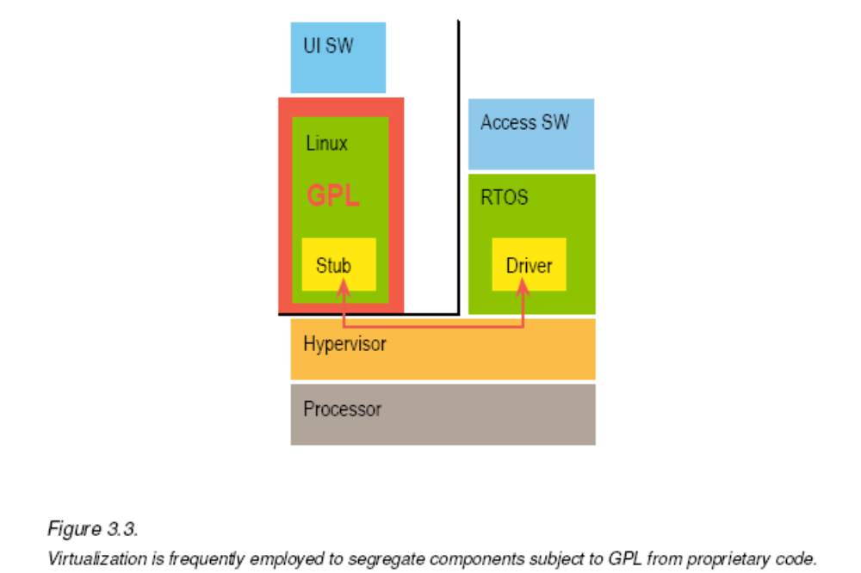
Interesting aside – License separation

Slide 6
Why not traditional virtualization for embedded systems?
Consolidation and Isolation are not that important in traditional embedded space
  Isolation conflicts with integration and performance
Current virtualization software is too complex
  TCB is too large
Embedded systems require
  High performance communication
  Device Sharing
  Integrated CPU scheduling
  Tight security requirements

Slide 7
Embedded Systems
Tightly integrated
Traditionally single (or limited) purpose
Focus on performance
But things are changing
  Mobile handset devices
    Communication stack must be strongly isolated from user apps for security

Slide 8
Microkernels
Precursors to virtualization technology
Small OS kernel
  Only performs resource control
  No services
  File systems, network stack, memory management (?) all implemented in user space.
High speed IPC critical for communication among components

Slide 9
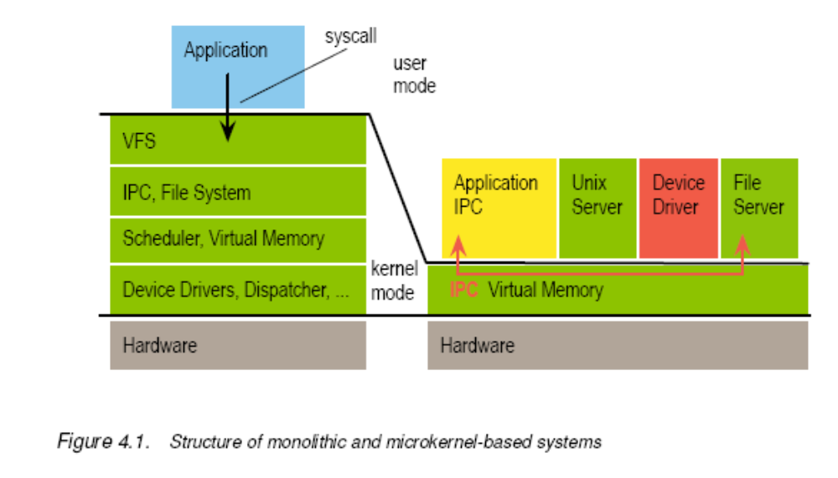
Monolitic vs Micro-kernels

Slide 10
Why Microkernels?
Small TCB
  Kernel
  Plus any user-level services for the system to perform correctly
More security
  If user-level apps are compromised, kernel is not
  Unless kernel trusts the user-level service (like file-system)
Apps can be either native or virtualized
For example, you can para-virtualize Linux to run on OKL4 microkernel.

Slide 11
So what is bottomline with microkernel?
Basically follows a para-virtualized model
More efficient than full-virtualization
But the claim of small TCP is questionable
  Since any useful functionality depends on a much larger user-level code base
Its not clear if integration is any better with microkernels
  One could argue that monolithic systems can be better integrated
Real-time guarantees
  Not clear if microkernels are best
  RTOS can be virtualized on top of a microkernel
  But RTOS will require absolute bounds on message transmission latency using IPC mechanisms

Slide 12
So why worry about either virtualization or microkernels in embedded space?
Moden embedded systems are far more complex (millions of LoC)
Require feature rich programming and execution environments
Which implies
  using traditional OSes and high-level APIs
  And maybe compromising somewhat on verifiability, and tight integration
Linux and Windows are becoming increasingly common in embedded space

Slide 13
Co-existence
Traditional OSes (TrOS) are not that good for real-time support
So virtualization can allow a traditional OS to co-exist with an RTOS on the same platform

Slide 14
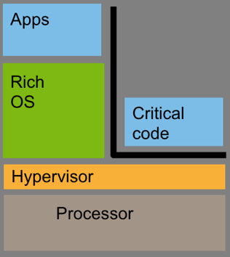
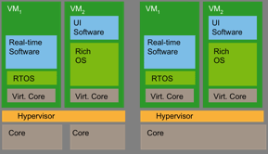
Resource partitioning
TrOS and RTOS run on separate cores
Memory strictly partitioned between the two

Slide 15
Examples of resource partitioning
Digital Right Management (DRM)
Pin-entry code for credit-card transactions
Communication stack of mobile phone
Isolating critical components can reduce certification costs

Slide 16
Requirements on hypervisor for embedded systems
Must run on different processors
  ARM, MIPS, etc. not just x86
Bounded short interrupt latencies
  Interrupt delivered to TrOS should not delay processing of RTOS tasks
Ability for tight integration
  Low-overhead, high-bandwidth, , low-latency communication channel between VMs
Plus of course
  Hardware-based Security and Reliability

Slide 17
KVM, Xen, OKL4
Open source
KVM
  Requires hardware support for virtualization
  Cannot run on MIPS or ARM for now
  Large TCB
  Real-time support limited
Xen
  Smaller TCB
  Slow Inter-VM communication (Use our XenLoop!)
  Minimal real-time support
  Works on ARM
OKL4
  Works on ARM, MIPS, x86
  Used on 250 million mobile phones
  64KB memory footprint

Slide 18
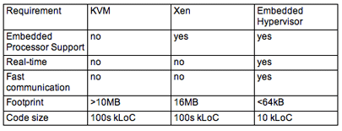

Slide 19
